Slide 1

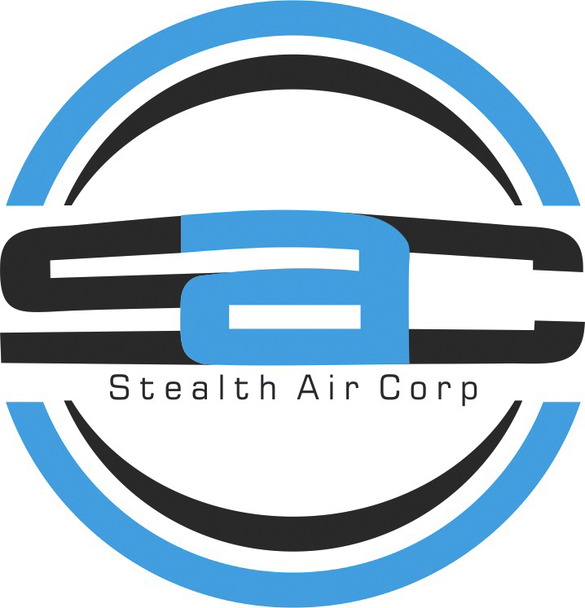
STEALTH AIR CORP.
Investor &
shareholder overview
Pioneering Technology Enabled
Services Businesses
September 2026
Notes:
Sources: Stealthaircorp August 2026 revision plan.docx; June-2026 Stealth website plan.docx. Territory correction supplied by management in this conversation: Southeast = Melbourne, FL to Miami, FL; Southwest = Tampa, FL to Naples, FL. Business statements reflect these supplied plans and are not independently audited. Background: original AI-generated conceptual artwork, not a photograph of actual company operations.

Slide 2
Business overview
Technology applied
to established industries
Current focus
Aero Land Surveyors
Supporting R&D
Stealth Air Innovation, Inc.
Stealth Air develops technology enabled services businesses. Land surveying is the first deployment of its operating approach.
STEALTH AIR CORP.
02
Notes:
Sources: Stealthaircorp August 2026 revision plan.docx; June-2026 Stealth website plan.docx. Territory correction supplied by management in this conversation: Southeast = Melbourne, FL to Miami, FL; Southwest = Tampa, FL to Naples, FL. Business statements reflect these supplied plans and are not independently audited.

Slide 3
Company development
2016
Founded as a drone company
Stealth Air developed a commercial application for drones in land surveying, then incorporated complementary geospatial technology and in-house workflow applications.
STEALTH AIR CORP.
03
Notes:
Sources: Stealthaircorp August 2026 revision plan.docx; June-2026 Stealth website plan.docx. Territory correction supplied by management in this conversation: Southeast = Melbourne, FL to Miami, FL; Southwest = Tampa, FL to Naples, FL. Business statements reflect these supplied plans and are not independently audited. Background: original AI-generated conceptual artwork.

Slide 4

AI + Pioneering Technology
Drone, LIDAR, GNSS/GPS
Field collection
Aerial capture, spatial measurements
and high-accuracy positioning.
Office production
AI integration, network infrastructure,
workflow applications and drafting.
STEALTH AIR CORP.
04
Notes:
Sources: Stealthaircorp August 2026 revision plan.docx; June-2026 Stealth website plan.docx. Territory correction supplied by management in this conversation: Southeast = Melbourne, FL to Miami, FL; Southwest = Tampa, FL to Naples, FL. Business statements reflect these supplied plans and are not independently audited. Background: original AI-generated conceptual LiDAR visualization.

Slide 5

Land surveying application
Aero Land Surveyors
Stealth Air combines novel technology with established data collection and data transfer methods to support the deployment of land surveying locations.
Digital twins/3D models and drafting support connect collected data with project deliverables.
STEALTH AIR CORP.
05
Notes:
Sources: Stealthaircorp August 2026 revision plan.docx; June-2026 Stealth website plan.docx. Territory correction supplied by management in this conversation: Southeast = Melbourne, FL to Miami, FL; Southwest = Tampa, FL to Naples, FL. Business statements reflect these supplied plans and are not independently audited. Aero Land Surveyors logo: https://aerolandsurveyors.com/wp-content/uploads/2024/08/Aero-Contact-e1620552119973.png (retrieved September 11, 2026).

Slide 6
Wholly owned subsidiaries
Stealth Air Innovation, Inc.
R&D entity responsible for innovative ideas that benefit Stealth Air Corp. and its subsidiaries.
Aero Land Surveyors Florida Southwest, Inc.
Licensed land surveying company serving Southwest Florida.
Aero Land Surveyors Florida Southeast, Inc.
Licensed land surveying company serving Southeast Florida.
STEALTH AIR CORP.
06
Notes:
Sources: Stealthaircorp August 2026 revision plan.docx; June-2026 Stealth website plan.docx. Territory correction supplied by management in this conversation: Southeast = Melbourne, FL to Miami, FL; Southwest = Tampa, FL to Naples, FL. Business statements reflect these supplied plans and are not independently audited.

Slide 7
Florida service territories
Southwest
Southeast
Tampa, FL
to Naples, FL
Melbourne, FL
to Miami, FL
Florida’s west coast
Florida’s southeast corridor
STEALTH AIR CORP.
07
Notes:
Sources: Stealthaircorp August 2026 revision plan.docx; June-2026 Stealth website plan.docx. Territory correction supplied by management in this conversation: Southeast = Melbourne, FL to Miami, FL; Southwest = Tampa, FL to Naples, FL. Business statements reflect these supplied plans and are not independently audited. Operating company links: https://aerolandsurveyors.com/florida-southwest and https://aerolandsurveyors.com/florida-southeast.

Slide 8
Strategic direction
Expand the Aero brand
Pursue additional land surveying locations.
Continue technology development
Support operating companies through R&D
and proprietary workflow applications.
Explore other industries where Stealth Air’s
technology and operating experience can apply.
STEALTH AIR CORP.
08
Notes:
Sources: Stealthaircorp August 2026 revision plan.docx; June-2026 Stealth website plan.docx. Territory correction supplied by management in this conversation: Southeast = Melbourne, FL to Miami, FL; Southwest = Tampa, FL to Naples, FL. Business statements reflect these supplied plans and are not independently audited. Strategic intentions, not forecasts or commitments. No dates or growth targets have been supplied. Background is conceptual AI-generated artwork.

Slide 9
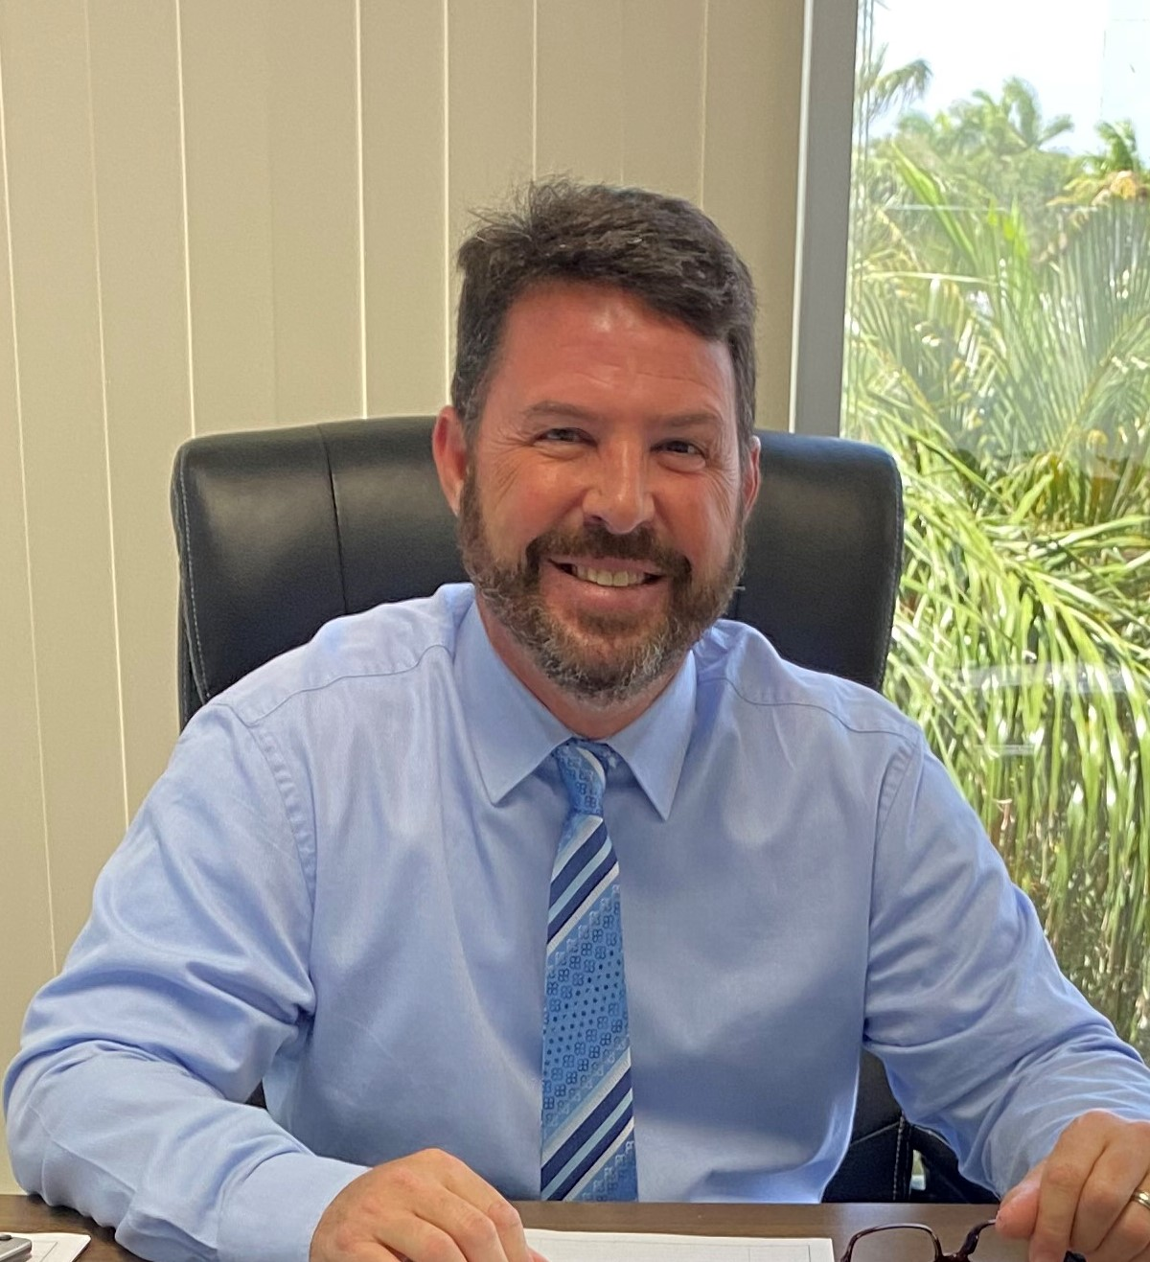
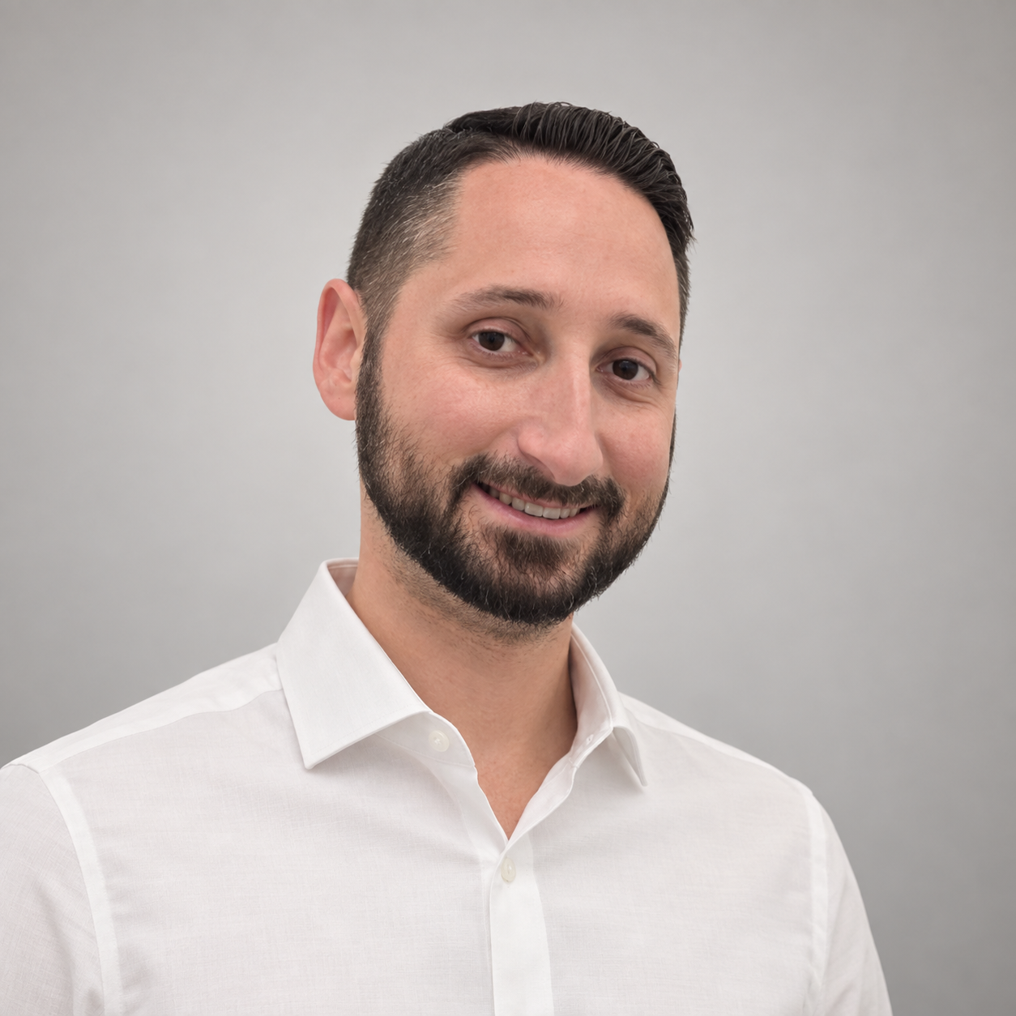
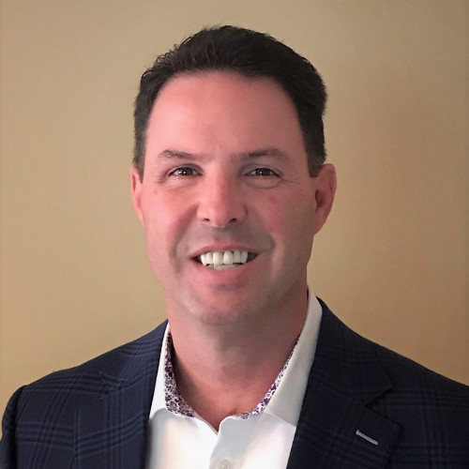
Executive officers
Craig Redding
Nicholas Addonisio
Gary Redding
Chief Executive Officer
President &
Chief Technology Officer
Chief Operations Officer
STEALTH AIR CORP.
09
Notes:
Sources: Stealthaircorp August 2026 revision plan.docx; June-2026 Stealth website plan.docx. Territory correction supplied by management in this conversation: Southeast = Melbourne, FL to Miami, FL; Southwest = Tampa, FL to Naples, FL. Business statements reflect these supplied plans and are not independently audited. Portraits supplied by the user. Chief Financial Officer name and portrait are forthcoming.

Slide 10
Directors & key personnel
Directors
Key personnel
Craig Redding
Teige Melia
Director, Acting Chairperson
Director of Flight Operations
Nicholas Addonisio
Snejana Jamie
Director, Acting Secretary
Director of Accounting
David Schwed
Eric Ding
Director
Director of IT
Chief Financial Officer: name forthcoming
STEALTH AIR CORP.
10
Notes:
Sources: Stealthaircorp August 2026 revision plan.docx; June-2026 Stealth website plan.docx. Territory correction supplied by management in this conversation: Southeast = Melbourne, FL to Miami, FL; Southwest = Tampa, FL to Naples, FL. Business statements reflect these supplied plans and are not independently audited.

Slide 11
Presentation scope & outlook
Business and strategy overview
This presentation describes the business and management’s strategic direction. It does not include financial results, valuation, a financing proposal or a securities listing timetable.
Expansion and technology development are intentions. Their timing and results depend on execution, resources and market conditions.
STEALTH AIR CORP.
11
Notes:
Sources: Stealthaircorp August 2026 revision plan.docx; June-2026 Stealth website plan.docx. Territory correction supplied by management in this conversation: Southeast = Melbourne, FL to Miami, FL; Southwest = Tampa, FL to Naples, FL. Business statements reflect these supplied plans and are not independently audited.

Slide 12
Shareholder Relations
(631) 888-3439
ir@stealthaircorp.com
stealthaircorp.com/shareholders
Company news and presentation downloads
STEALTH AIR CORP.
12
Notes:
Sources: Stealthaircorp August 2026 revision plan.docx; June-2026 Stealth website plan.docx. Territory correction supplied by management in this conversation: Southeast = Melbourne, FL to Miami, FL; Southwest = Tampa, FL to Naples, FL. Business statements reflect these supplied plans and are not independently audited. Background: original AI-generated conceptual artwork.

